Slide 2
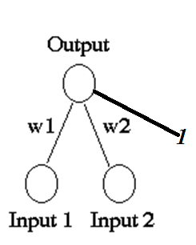
x₁ | x₂ | y
1 | 1 | 1
1 | 0 | -1
0 | 1 | -1
0 | 0 | -1
A perceptron for the AND function is defined
as follows :
Binary inputs ( 0/1),
Bipolar targets ( ±1)
Initial weights and bias equal to 0,
threshold = 0.2=θ

Slide 3
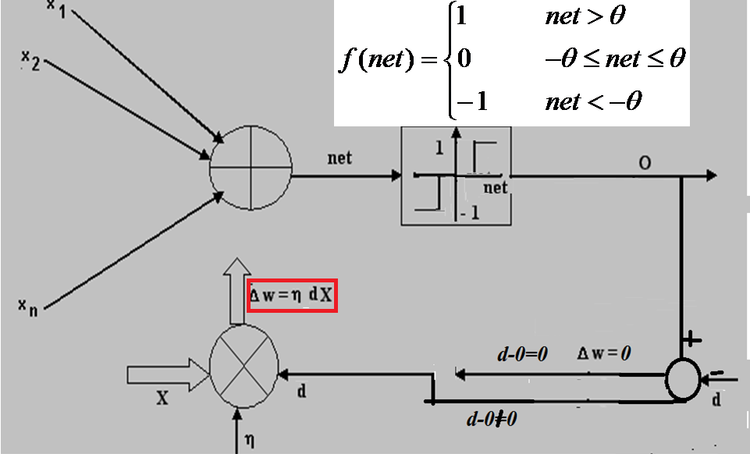
0.2=θ
Rule Given
Perceptron learning rule

Slide 4
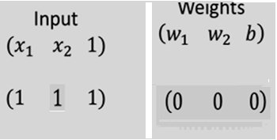
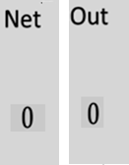
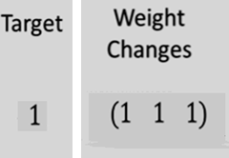
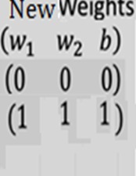
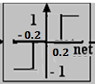
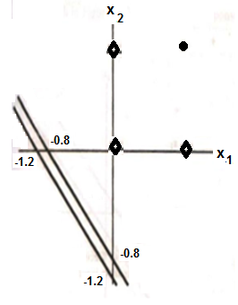
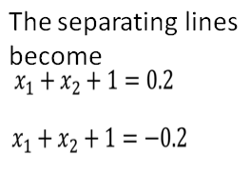

AND GATE : Presenting the first input
Based on new weight (1 1 1) and input (x₁ ,x₂ ,x₃ ), output=x₁+x₂ +1
x₁ | x₂ | y
1 | 1 | 3 →1
1 | 0 | 2→1 not-1
0 | 1 | 2→1 not-1
0 | 0 | 1→1 not -1

Slide 5
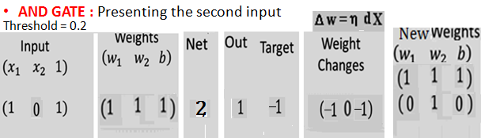
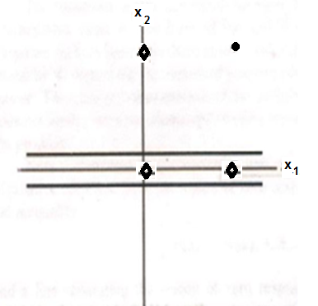
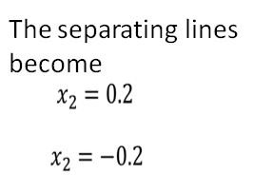
Based on new weight (0 1 0) and input (x₁ x₂ x₃ ) o/p= X₂ = 0.2 so output for all cases will be 1, i.e. correct for case 1 only
x₁ | x₂ | y
1 | 1 | 1→1
1 | 0 | 1→1 not -1
0 | 1 | 1→1 not -1
0 | 0 | 0→0 not -1

Slide 6
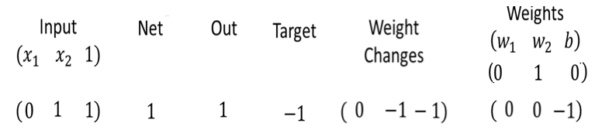
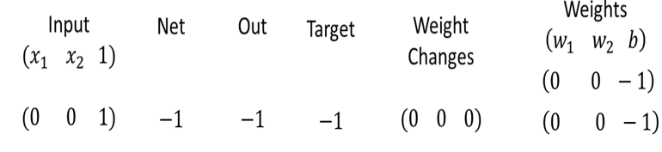
Presenting the third input yields the following
Response of net will be negative (correct) for all inputs,( as net=-1 for all four cases, so output = -1 for all cases, incorrect for first input
Presenting the fourth input yields the following
The response for all of the input patterns is negative for the weights derived; but since the response for the input pattern (1,1) is not correct, we need to perform one more EPOCH

Slide 7
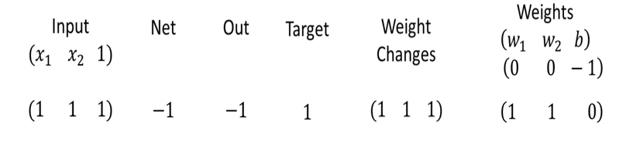
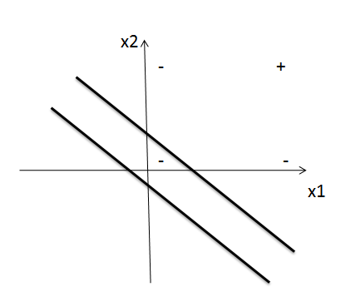
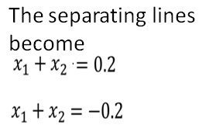
SECOND EPOCH, FIRST TRAINING INPUT
Based on new weight (1 1 0) and input (x₁ x₂ x₃ )
Output = x₁ + x₂
x₁ | x₂ | y
1 | 1 | 2 →1
1 | 0 | 1→1 not-1
0 | 1 | 1→1 not-1
0 | 0 | 0→0 not -1
The response of the net will now be correct for (1,1) , but not correct for other three inputs

Slide 8
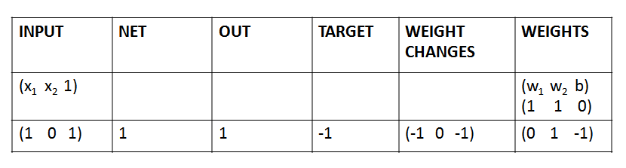

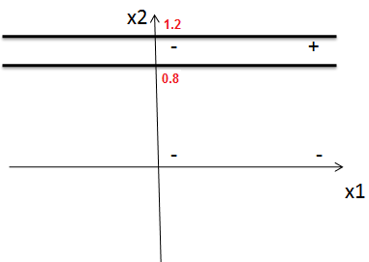
SECOND EPOCH, SECOND TRAINING INPUT
Based on new weight (0 1 -1) , output = x₂ -1
x₁ | x₂ | y
1 | 1 | 0 →0,not1
1 | 0 | -1→-1
0 | 1 | 0→0 not-1
0 | 0 | -1→-1
Response of net will now be correct ( negative) for (1,0) and (0,0) and response for (0,1) and (1,1) will be 0, not correct should 1

Slide 9
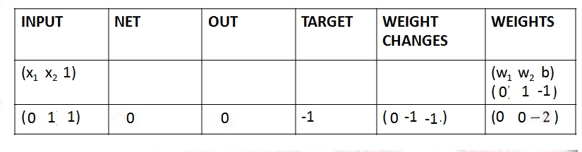
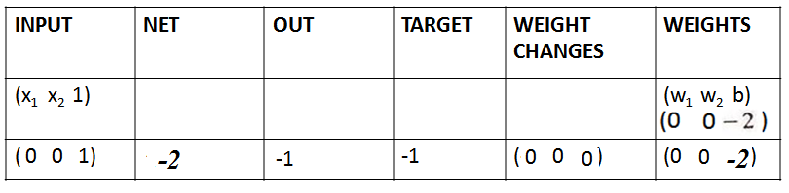
SECOND EPOCH, THIRD TRAINING INPUT
RESPONSE WILL BE NEGATIVE FOR ALL INPUTS
SECOND EPOCH, FOURTH TRAINING INPUT
RESPONSE WILL BE NEGATIVE FOR ALL INPUTS

Slide 10
Finally, the results for the tenth epoch are:
INPUTS NET OUTPUT TARGET WEIGHT WEIGHTS
CHANGES
(1 1 1) | 1 | 1 | 1 | (0 0 0) | (2 3 -4)
(1 0 1) | -2 | -1 | -1 | (0 0 0) | (2 3 -4)
(0 1 1) | -1 | -1 | -1 | (0 0 0) | (2 3 -4)
(0 1 1) | -4 | -1 | -1 | (0 0 0) | (2 3 -4)
Based on new weights (2 3 -4) output =2x₁ +3x₂ - 4
Separating line : 2x₁ + 3x₂ -4 = ±0.2
x₁ | x₂ | y
1 | 1 | 1 →1
1 | 0 | -2→-1
0 | 1 | -1→-1
0 | 0 | -4→-1

Slide 11
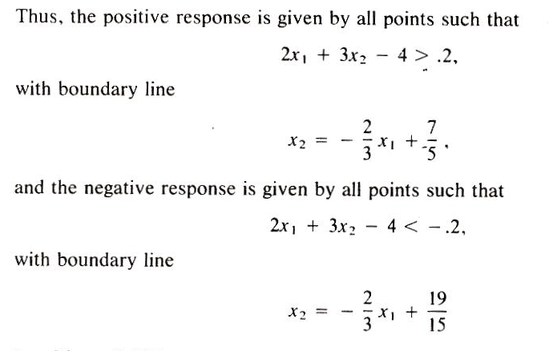
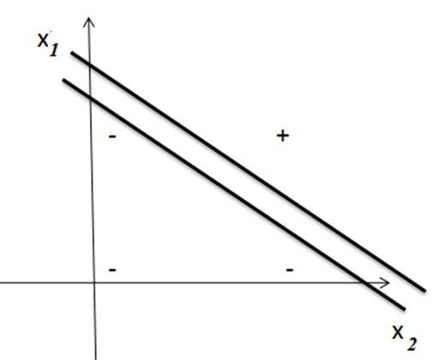

Slide 12
